Slide 1

To-Do list
Python workshop

Slide 2
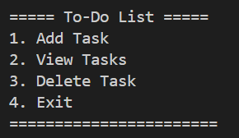
What is a To-Do List?
A To-Do List is a small program that lets users manage their tasks.

Slide 3
What can we do with this to-do list
Add Task 👈 Add something you need to do
View Tasks 👈 See all tasks you've added
Delete Task 👈 Remove a task you finished or don’t need
Exit 👈 Close the program

Slide 4
Where it's used in real life ?
Office Task Manager
E-commerce Order Processing
Event Planning Checklist
Hospital Task Board

